Slide 1
Multimodal & Nonverbal
3D Facial Animation Generation
Author：Yu Junwei

Slide 2
My Previous Research

Slide 3
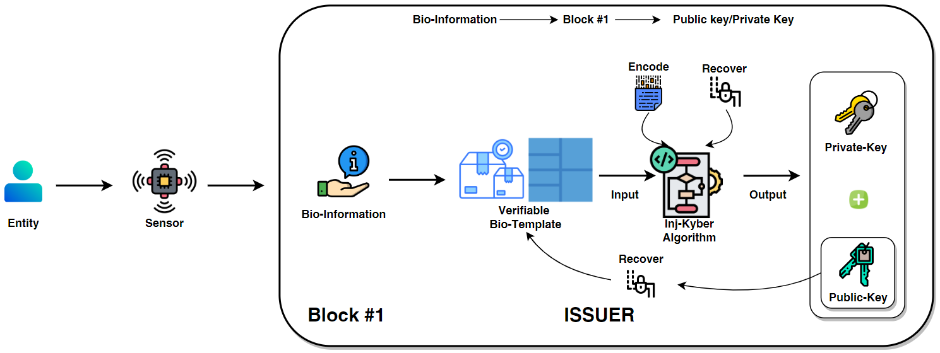
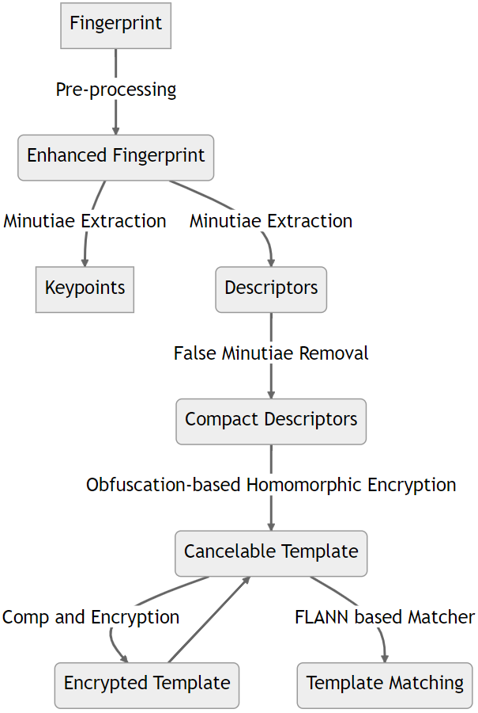
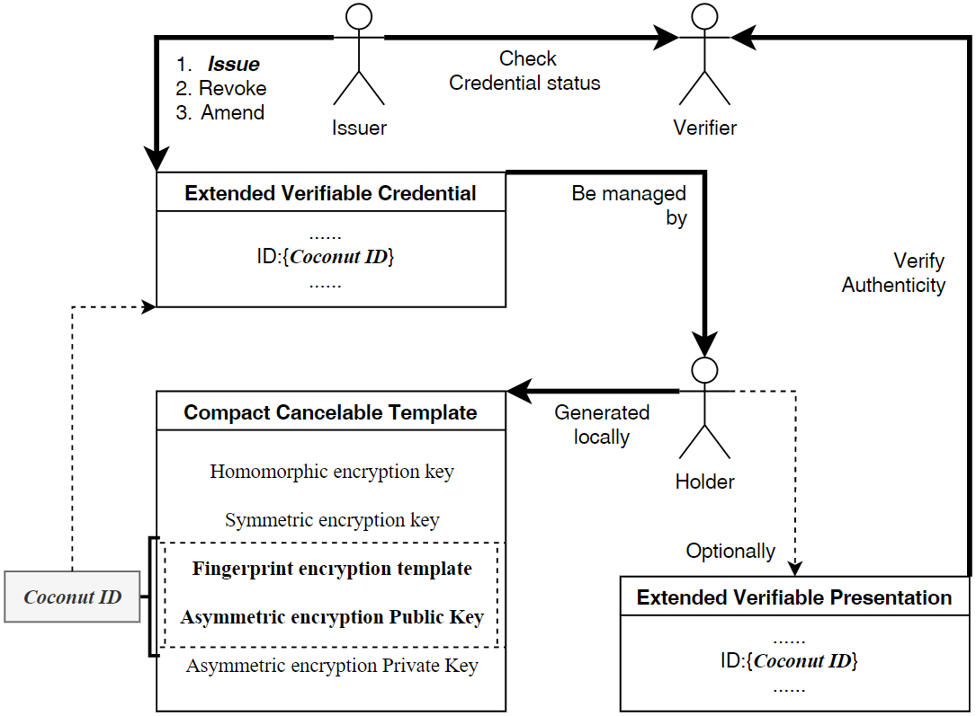

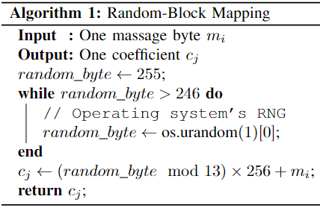
Coconut: A Novel Decentralized Self-Sovereign Identity Management System
Quantum-Resistant & Self-Sovereign Identity
Biometric & Privacy-Secure
Introduction
Compact Cancelable Template Generation
Coconut
Decentralized Identity Management System
with Biometrics
Quantum-Resistant & Self-Sovereign
CHEAP and SOLID!
False Minutiae Removal Algorithm
+
Homomorphic Obfuscation Encryption Algorithm
The Compact Cancelable Template Generation Algorithm is proposed, which presents a comprehensive fingerprint-based verifiable template generation process.
The INJ-KYBER algorithm, built upon CRYSTALS-KYBER, enables the injection of information into the public key, establishing a natural association between the information and the public key.
The Coconut Identity Management System is a deployable SSI system that efficiently addresses the challenges of multiple identities and statement verification, offering a solution that is both cost-effective and secure.
Compact Cancelable Template
INJ-KYBER
Post-quantum cryptography
+
Injecting information into public key
Summary
Impressively low error rate of 0.0325
Noteworthy average CR of 5.86%
Info is injected into post-quantum pub-key
Cost-effective and secure SSI system

Slide 4
Previous Work at Huawei

Slide 5
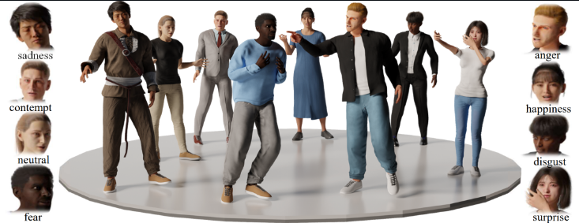
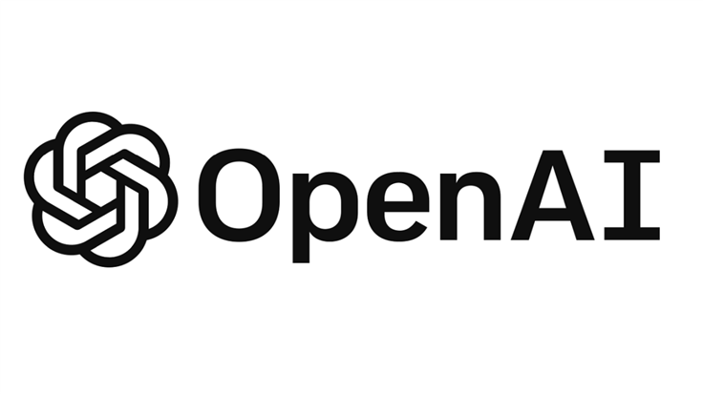
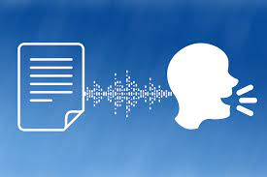
Project Landing
BEAT:
A Large-Scale Semantic and Emotional Multi-Modal Dataset for Conversational Gestures Synthesis
Text
Audio
Facial Expression
Body and Hands

Slide 6

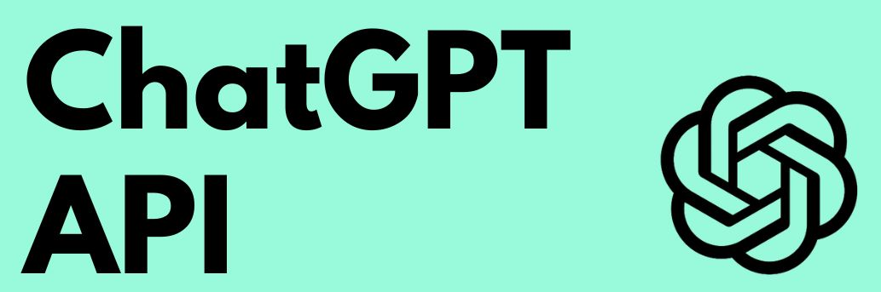
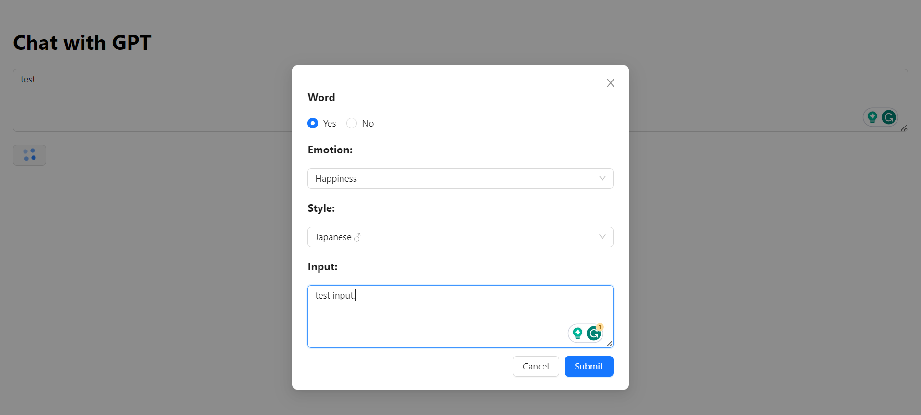
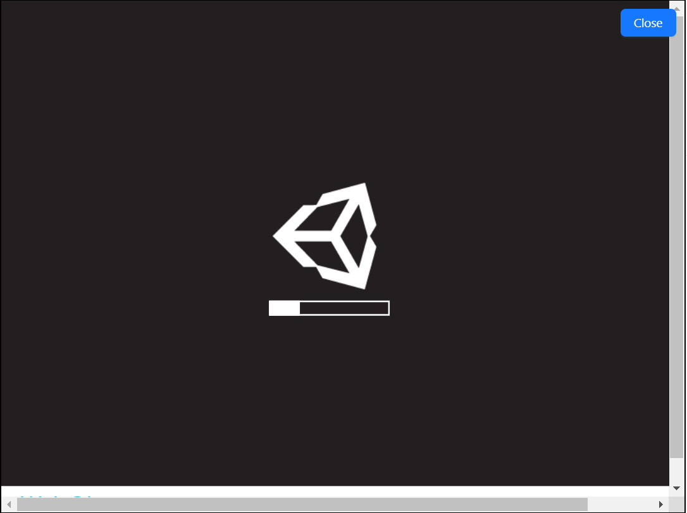
Web Application
Dva.js
WEB APPLICATION
Python-Flask
TTS-Model
BEAT-Model
Unity-WebGL

Slide 7



Live Stream
Monitor live stream Danmaku
AI LIVE STREAM
TTS-Model
BEAT-Model
Unity-WebGL
Open Broadcaster Software

Slide 8
Previous Attempts at Huawei

Slide 9

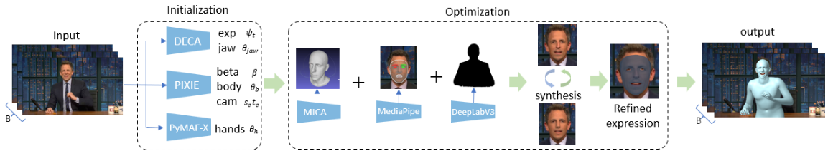
2D Video to 3D Motion
Motion Capture & Body Tracking
FBX & BVH
Real Human √ Cartoon Figure ×
Human Video
SMPL-X
Complete Upper Body with Hand

Slide 10
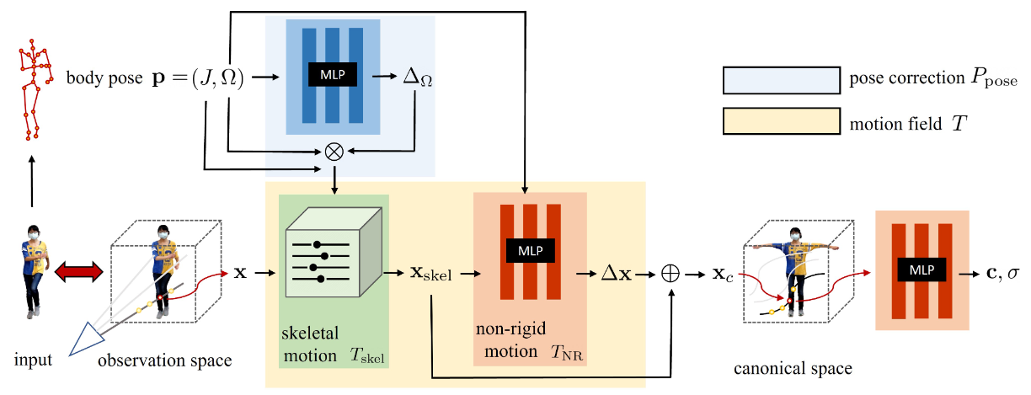
HumanNeRF + Diffusion
Insufficient sampling
The rendering is blurry
Dream3D
DreamFusion
Make-It-3D
…
Free-viewpoint Rendering of Monocular Videos with Insufficient Sampling
Diffusion Model Predicting Unsampled Perspective Frames
Continuity ?

Slide 11
Current Research

Slide 12
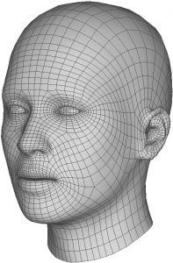
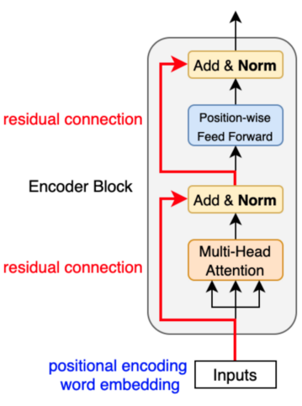
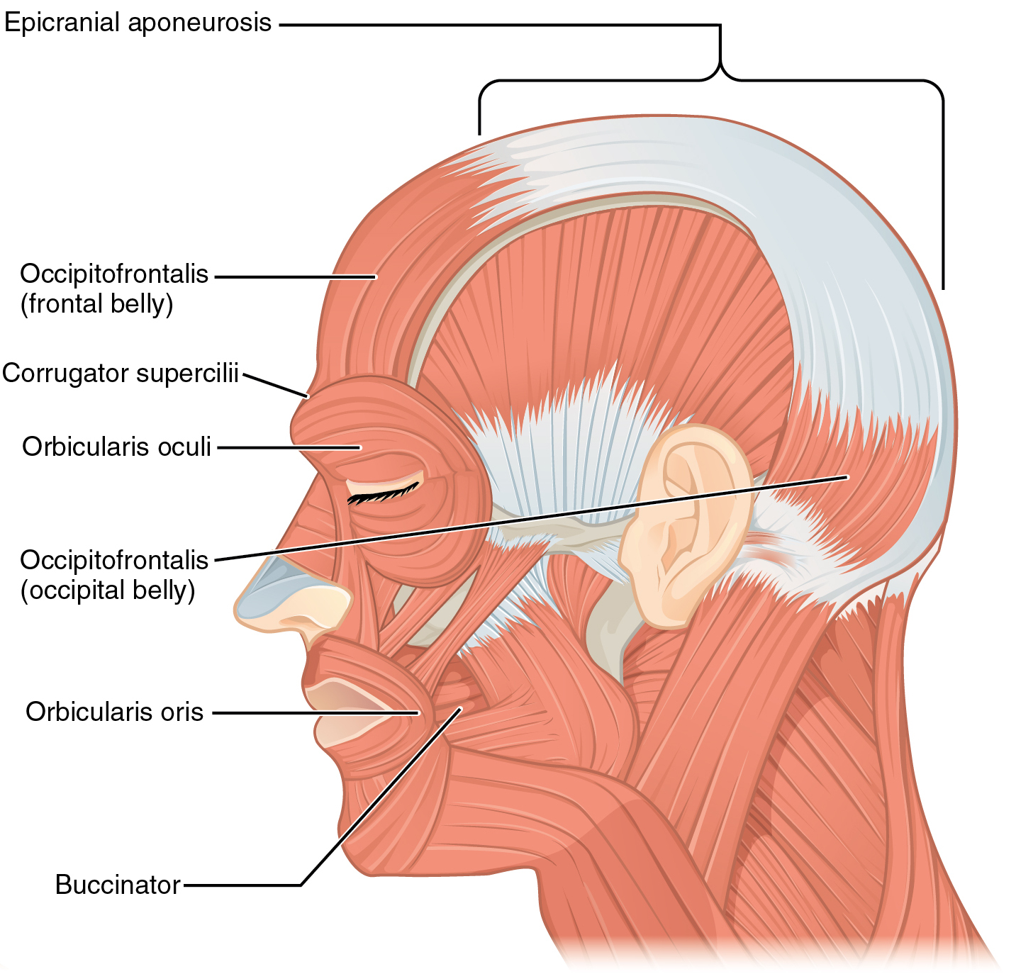
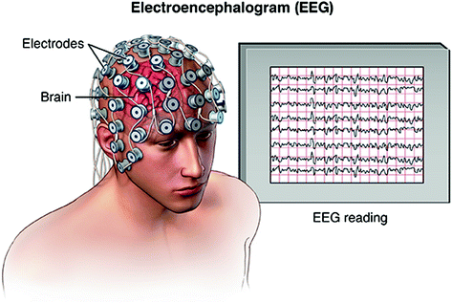
Nonverbal Facial Animation Generation
CodeTalker
FaceFormer
…
Speech-Driven 3D Facial Animation
Nonspeech?
Encoders
Codebooks
Decoders
shifted exponential
processing
Transformer

Slide 13
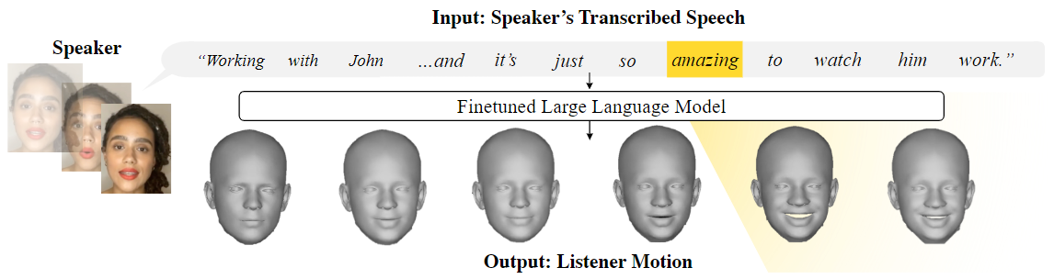
Nonverbal Facial Animation Generation
Nonspeech.
Can Language Models Learn to Listen?
——Listener Motion Generation with LLMs
→ Words to 3DMM
Dataset: Learning to Listen: Modeling Non-Deterministic Dyadic Facial Motion
VQ-VAE + Transformer
Notes:
我们使用 EMOCA [14,17] ，这是一个比 DECA [16]更具表现力的模型，

Slide 14
Nonverbal Facial Animation Generation
From text but speech
No personality of listener
Can Language Models Learn to Listen?
Speech encoder →
Happiness, surprise, contempt, sadness, fear, disgust, and anger….
Empathy 2+ Dimensions
Facial Animation
Comparison with Prediction results
Degree of identification
Head Pose
Mesh Emoji
Mesh vertex
Tri-plane
Gauss ball

Slide 15
Nonverbal Facial Animation Generation
Mesh Emoji
Mesh vertex
Tri-plane
Gauss ball
表情机的结果会更加令人满意，但是其维度较低，很多表情由于表情机有限，所以无法生成，同时结果也缺乏个体差异性。
顶点作为baseline是业界比较多的做法，有丰富的代码可以参考，但其缺点也很明显，低成本的数据集以及缺乏生动和细节的表情。
NeRF的baseline，结果十分令人满意，但是数据集缺乏并且成本很高，录制需要多摄像头同步，每帧渲染也需要大量的算力。
很新的方向，工作很少，如果尝试会很容易被接受。但是同样的成本很高，而且效果不一定比tri-plane更好。
Gaussian Head Avatar: Ultra High-fidelity Head Avatar via Dynamic Gaussians

Slide 16
RW
Conversational dynamics Works on animating conversa- tional avatars traditionally involved crafting rule-based de- signs on lab-captured motion data [8, 20, 25, 3, 43], which often limit the variety of captured gestures, or rely on sim- plifying assumptions for motion generation that do not hold for in-the-wild data. As a result, several data-driven ap- proaches were proposed for tasks such as predicting the head pose of the speaker and listener [21], turn taking [28, 1], and single-frame facial expressions that summarize the se- quence [26, 36]. While these methods focus on a narrow aspect of modeling social dynamics, our approach captures the natural complexity of interactions by considering the full range of facial expressions and head rotations.
More recently, there have been works on modeling a speaker’s fine-grain motion generation conditioned on au- dio [27, 19], [12] text, or both audio and text [30]. However, all these works focus on modeling monadic conversational settings where the goal is to output speaker motion that directly matches the input signals. In contrast, [15, 27, 35, 50] model cross-person, dyadic interactions by predicting the lis- tener’s 2D [15] or 3D motion [27, 35, 50]. Yet all these prior works condition the listener’s response on the speaker’s mo- tion and audio. In addition, [50] relies on a one-bit semantic affect conditioning that signifies whether the synthesized lis- tener should have a positive, negative, or neutral response. In contrast, we focus on demonstrating that semantically meaningful and temporally realistic responses that correspond to a given speaker are possible from a text-only context.
Most related to our work is [18], which explicitly models the semantics within a conversation. By prompting GPT3 [6] with a predefined goal and text of the speaker, [18] obtains visual details of the listener from which they train a model to retrieve listener clips that most closely match this de- scription within their dataset. Rather than taking the full input text at once, our model ingests time-aligned text and autoregressively outputs corresponding 3D listener motion. Additionally, we generate raw 3D motion rather than pick- ing from existing clips, which allows us to derive motion that does not exist in the training set. All these differences allow us to model both semantics and temporally realistic responses in dyadic conversations.
Notes:
Quantum-Resistant Cryptographic Algorithms

Slide 17

KYBER
Module-Lattice-Based
Public-Key Cryptography
CRYSTALS-Kyber
Learning with Errors
Polynomials-Ring
t=As+e
Private key: s
Public key: (A,t)
a b
c d
A
Notes:
Quantum-Resistant Cryptographic Algorithms

Slide 18
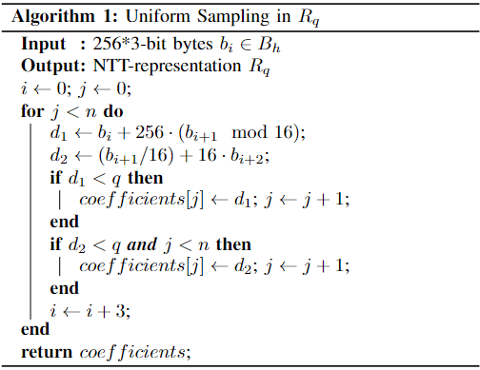
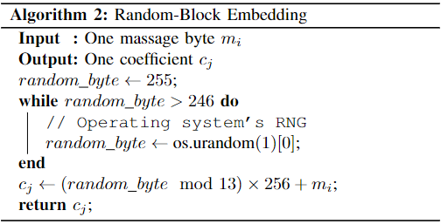
Random-Block Mapping
Information
Matrix A

Slide 19
Overview of Coconut
Notes:
Figure illustrates the key components and interactions within the Coconut ecosystem. The user, as the holder, plays a central role by generating a local Coconut ID using the Compact Cancelable Template Generation algorithm. This algorithm guarantees the creation of a unique and unlinkable identifier, protecting the user's privacy while maintaining the necessary security.
\item The user, as the holder, initiates the system by locally generating a unique coconut ID using the Compact Cancelable Template Generation algorithm. This algorithm ensures the creation of a secure and privacy-preserving identifier.
\item The holder has the option to request a verifiable credential from the issuer. To obtain this credential, the holder's identity is verified by the issuer. Once the verification is completed, the issuer digitally signs the verifiable certificate, incorporating the coconut ID, and transmits it to the user.
\item The holder maintains a local repository for managing the received verifiable credentials. Optionally, the holder can generate a verifiable presentation that encapsulates one or more verifiable credentials. This presentation serves as a concise and structured representation of the holder's credentials. \item The holder presents the verifiable credentials, either individually or within a verifiable presentation, to a verifier. The presentation enables the holder to provide relevant and trustworthy information to the verifier in a secure manner.
\item The verifier undertakes the task of verifying the authenticity and integrity of the received verifiable credentials or verifiable presentation. Additionally, the verifier verifies the user's digital identity by using suitable verification mechanisms. This process includes verifying the credential status to ensure the non-revocation of the verifiable credentials as provided by the issuer.\end{enumerate}

Slide 20
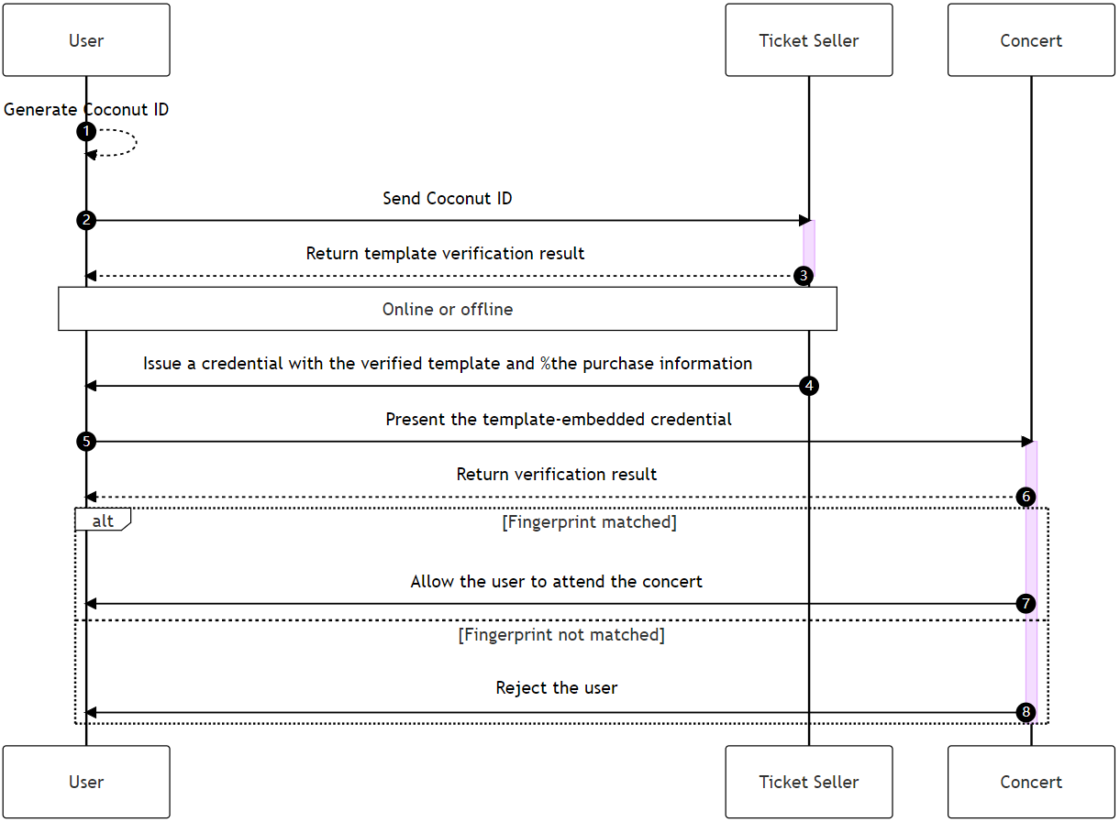
Practical Scenarios
Notes:
In the presented use case, a user intends to purchase a concert ticket from a third-party seller. The user generates a cancelable fingerprint template locally and transmits it to the ticket seller for verification. The verification process can occur online or offline, with strict security requirements mandating in-person validation. Upon successful verification, the ticket seller issues a ticket in the form of a fingerprint template embedded credential, signed using the seller's key pair to prevent tampering. On the event day, the attendee presents the credential, and the embedded template is converted into a cancelable template for verification against the attendee's biometric information, ensuring the rightful ticket owner is granted entry.Our research efforts have culminated in the successful development and implementation of a framework that seamlessly integrates biometric information into verifiable credentials, establishing a robust and trustworthy link between digital identities and their corresponding physical entities. Through the utilization of Coconut ID and the collaborative participation of VC, our ecosystem has effectively overcome the limitations and vulnerabilities of current SSI technologies.

Slide 21
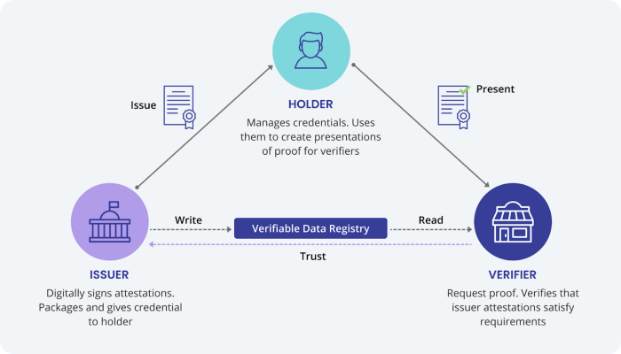
Coconut-ID:
Biometric-Based Key generation and Self-sovereign identity
User applies for digital identity
Generate Biometric-Based Key
Issuer authenticate user identity
Issue signed verifiable credential
User generate verifiable presentations
User encrypt via private key
Verifier verifies Issuer and VP
Verifier authenticate user identity
Notes:
Some companies verify the profiles of workers and issue employment credentials to authenticate their past employment. The holders are the workers themselves on whom the credential is issued while verifiers are those to whom the holder shares the credential issued by the issuer.
Another example is when a holder shares a date of birth verifiable credential with the bar manager to prove that he is over 18 years of age.
Here, the issuer is a government entity or a startup that has verified the holder’s records while the verifier is the restaurant manager.

Slide 22
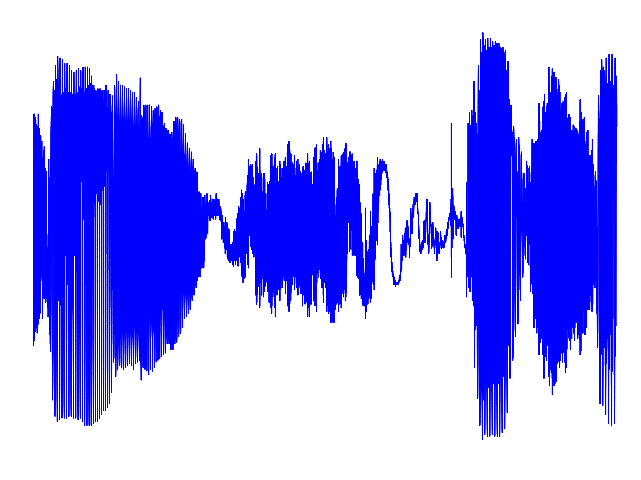
Model Design
Sparse multimodal
Wav2vec
Encoder
Sparse cross-modal attention
MFCC
Autoregressive Model
Compositional Codebooks
Encoders
Decoders
shifted exponential
processing
Transformer
Notes:
This is because this model represents the feature vector space, and the advantage of doing so is that we can better explain the driving effect of brain waves on expressions.
Mel-Frequency Cepstral Coefficients
Is a feature representation method for audio signal processing and speech recognition. It is a feature extraction technique commonly used in sound analysis
Autoregressive Model
It is a common time series modeling method used to predict the next value in time series data. The predicted value is a linear combination of values from past time points, and is typically modeled and predicted using recursive methods.

Slide 23
Coconut: A Novel Decentralized Self-Sovereign Identity Management System
54-MU
Sato Lab. M2 37-226563 Yu Junwei
Introduction
Compact Cancelable Template Generation
Coconut
Decentralized Identity Management System
with Biometrics
Quantum-Resistant & Self-Sovereign
CHEAP and SOLID!
False Minutiae Removal Algorithm
+
Homomorphic Obfuscation Encryption Algorithm
The Compact Cancelable Template Generation Algorithm is proposed, which presents a comprehensive fingerprint-based verifiable template generation process.
The INJ-KYBER algorithm, built upon CRYSTALS-KYBER, enables the injection of information into the public key, establishing a natural association between the information and the public key.
The Coconut Identity Management System is a deployable SSI system that efficiently addresses the challenges of multiple identities and statement verification, offering a solution that is both cost-effective and secure.
Compact Cancelable Template
INJ-KYBER
Post-quantum cryptography
+
Injecting information into public key
Summary
Impressively low error rate of 0.0325
Noteworthy average CR of 5.86%
Info is injected into post-quantum pub-key
Cost-effective and secure SSI system

Slide 24
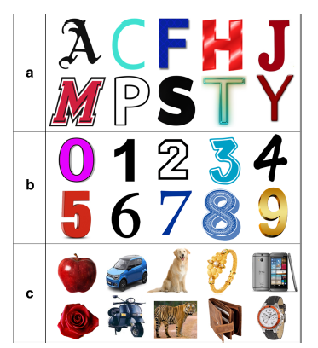
Background
High-resolution image reconstruction with latent diffusion models from human brain activity
—— CVPR 2023
EEG2IMAGE: Image Reconstruction from EEG Brain Signals
—— ICASSP 2023
Envisioned speech recognition using EEG sensors
—— Pers Ubiquit Comput 22
Twenty-three subjects
Emotiv EPOC+ 14C
Total 690 recordings
Classification task
Notes:
This is because this model represents the feature vector space, and the advantage of doing so is that we can better explain the driving effect of brain waves on expressions.
Mel-Frequency Cepstral Coefficients
Is a feature representation method for audio signal processing and speech recognition. It is a feature extraction technique commonly used in sound analysis
Autoregressive Model
It is a common time series modeling method used to predict the next value in time series data. The predicted value is a linear combination of values from past time points, and is typically modeled and predicted using recursive methods.

Slide 25
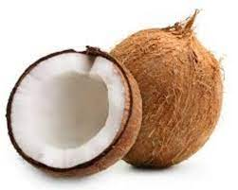
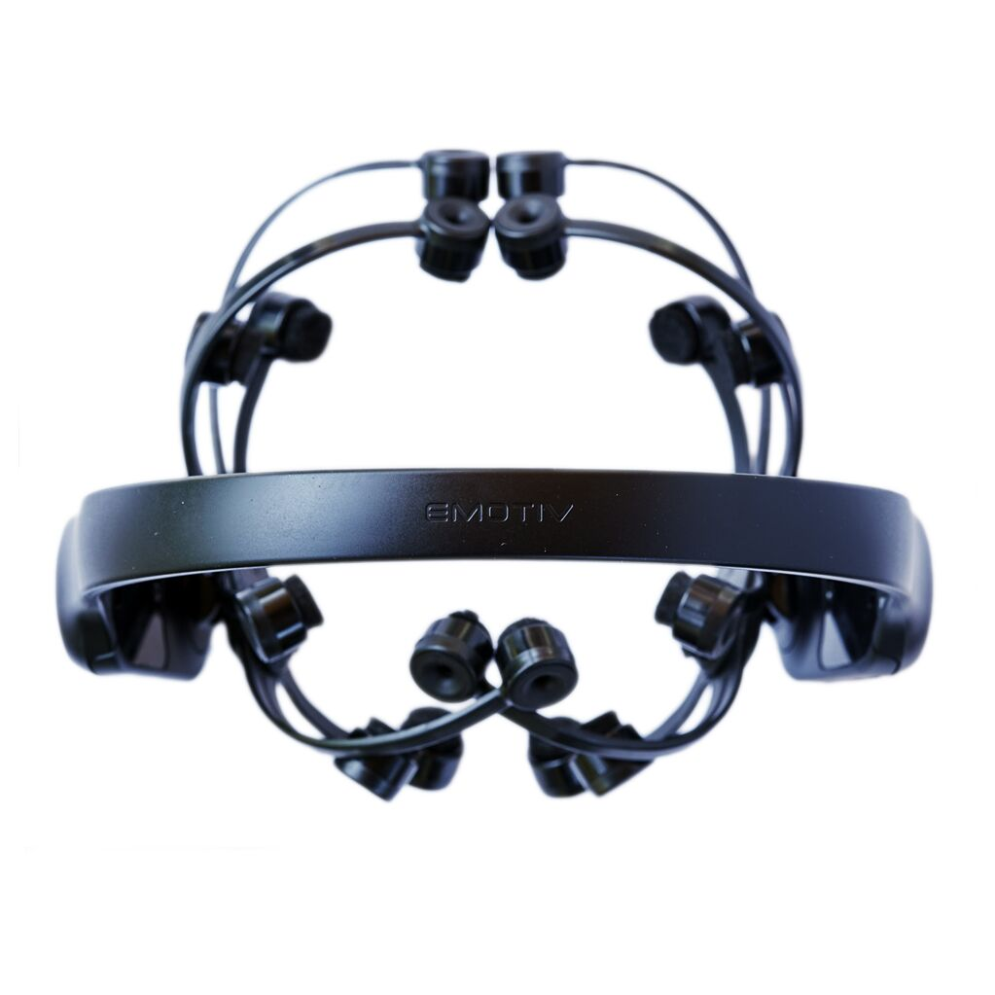
Dataset Design
Picture
EMOTIV EPOC X 14 Channel Mobile Brainwear
EEG
Stimuli → Image + Text
Within 5 seconds (1 second interval)
Read out the Text
Coconut
Text
Notes:
This is because this model represents the feature vector space, and the advantage of doing so is that we can better explain the driving effect of brain waves on expressions.
Mel-Frequency Cepstral Coefficients
Is a feature representation method for audio signal processing and speech recognition. It is a feature extraction technique commonly used in sound analysis
Autoregressive Model
It is a common time series modeling method used to predict the next value in time series data. The predicted value is a linear combination of values from past time points, and is typically modeled and predicted using recursive methods.

Slide 26
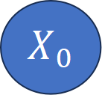
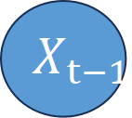
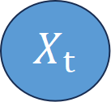
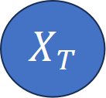
Model Design
Clip Text
Encoders
Coconut
Cross-Attention
$$X_{T}$$
$$X_{t}$$
$$X_{t−1}$$
$$X_{0}$$
Encoders
Decoders
Diffusion model
Cross-Attention
EEG-TCN
Encoders
Notes:
This is because this model represents the feature vector space, and the advantage of doing so is that we can better explain the driving effect of brain waves on expressions.
Mel-Frequency Cepstral Coefficients
Is a feature representation method for audio signal processing and speech recognition. It is a feature extraction technique commonly used in sound analysis
Autoregressive Model
It is a common time series modeling method used to predict the next value in time series data. The predicted value is a linear combination of values from past time points, and is typically modeled and predicted using recursive methods.

Slide 27
Note
人机交互的论文
https://github.com/SforAiDl/neuroscience-ai-reading-course/tree/master/Divisha_2017A7PS0959G/Imagined_Speech_Classification_Using_EEG
数据集
https://github.com/meagmohit/EEG-Datasets?tab=readme-ov-file
EEG-Image数据集
https://mindbigdata.com/opendb/imagenet.html
两篇没有发的branchmark—— https://arxiv.org/abs/2306.16934
https://arxiv.org/abs/2308.02510
Notes:
This is because this model represents the feature vector space, and the advantage of doing so is that we can better explain the driving effect of brain waves on expressions.
Mel-Frequency Cepstral Coefficients
Is a feature representation method for audio signal processing and speech recognition. It is a feature extraction technique commonly used in sound analysis
Autoregressive Model
It is a common time series modeling method used to predict the next value in time series data. The predicted value is a linear combination of values from past time points, and is typically modeled and predicted using recursive methods.

Slide 28
Note
图片数据：
处理图片数据时，可以通过以下步骤引入拉普拉斯噪声：
定义敏感度： 对于图像数据，敏感度可以通过像素值的范围来定义。例如，对于8位灰度图像，像素值范围为0到255，因此敏感度为255。
计算梯度： 计算图像的梯度，即每个像素相对于其周围像素的变化。这可以通过一些图像处理技术来实现，如Sobel算子。
为每个像素添加拉普拉斯噪声： 对于每个像素，根据计算的梯度值，使用拉普拉斯分布生成一个噪声值，然后将其添加到原始像素值上。这个过程可以在图像的每个像素上进行。
音频数据：
对于音频数据，加入拉普拉斯噪声的过程类似：
定义敏感度： 对于音频数据，可以将敏感度定义为音频样本值的范围，通常为[-1, 1]。
计算梯度： 在音频中，梯度可以表示为相邻样本之间的变化。
为每个样本添加拉普拉斯噪声： 对于每个音频样本，根据计算的梯度值，使用拉普拉斯分布生成一个噪声值，然后将其添加到原始样本值上。
文本数据：
对于文本数据，差分隐私的应用可能涉及到对词频、语法结构等进行处理。具体步骤可能包括：
定义敏感度： 对于文本数据，可以根据词频或其他度量来定义敏感度。
计算梯度： 在文本中，梯度可以表示为词频的变化或者与相邻词的关系。
为每个词添加拉普拉斯噪声： 对于每个词，根据计算的梯度值，使用拉普拉斯分布生成一个噪声值，然后将其添加到原始词频上。
Notes:
This is because this model represents the feature vector space, and the advantage of doing so is that we can better explain the driving effect of brain waves on expressions.
Mel-Frequency Cepstral Coefficients
Is a feature representation method for audio signal processing and speech recognition. It is a feature extraction technique commonly used in sound analysis
Autoregressive Model
It is a common time series modeling method used to predict the next value in time series data. The predicted value is a linear combination of values from past time points, and is typically modeled and predicted using recursive methods.

Slide 29
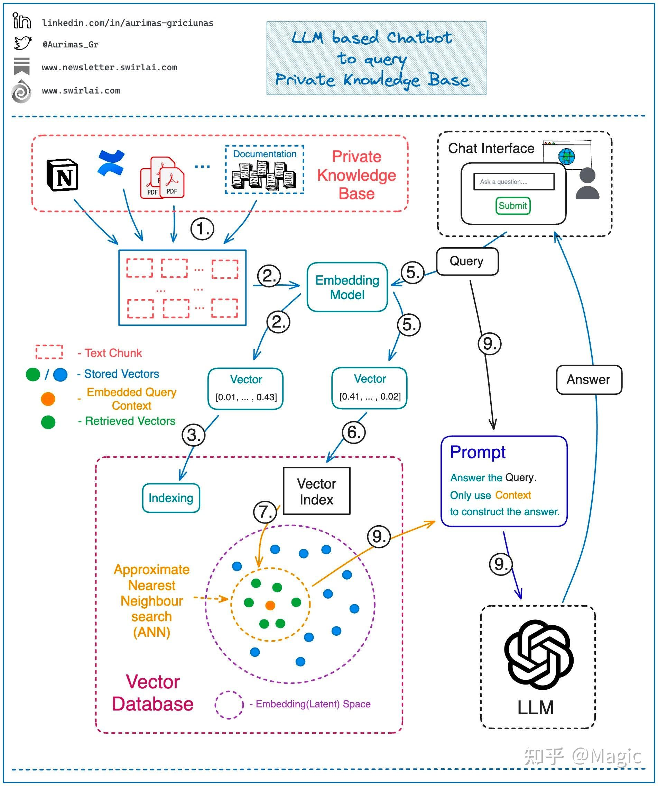
外挂私有库——Vectorstore （LangChain）
本地GPT——ChatGLM & Vicuna & Fauxpilot & Wenda
ChatGPT_fine-tuning——https://platform.openai.com/docs/guides/fine-tuning
语料生成微调样本——https://zhuanlan.zhihu.com/p/629591953
https://github.com/CogStack/opengpt
https://my.oschina.net/oscpyaqxylk/blog/8727824

Slide 30
Localized Natural Language Model

Slide 31
Vectorstore
Document
Text Chunk
Embedding
Vector
Embedding
Model
Indexing
→
Vector Index
Chat History
Query
Prompt
Answer the Query.
Only use Context
to construct the answer.

Slide 32
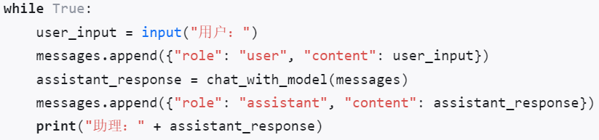
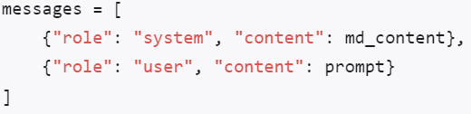
Vectorstore
LangChain——
1、加载文件内容
2 - 计算文件的 SHA1
3 - 添加 SHA1 作为元数据
4 - 添加到Supabase vectorstore
1 - 文件的内容
2 - 文件的元数据信息
3 - 使用OpenAI Embeddings来计算文件的向量值
1 - 选择模型（GPT3.5 或 GPT4）
2 - 使用Supabase vectorstore 创建 CoversationalRetrievalChain
3 - 发送问题，然后在Streamlit中显示查询结果
上传新文件时：
1 - 通过计算文件 SHA1 来检查它是否已经存在
2 - 通过查询Supabase元数据列来检查它
如果一条信息的role是user，则表明这是用户向模型发送的聊天信息，相当于是Completion模型中的prompt，而如果一条信息的role是assistant，则表示这是当前模型围绕某条用户信息做出的回应，相当于是相当于是Completion模型中的text。

Slide 33
Localized Natural Language Model
LangChain——
构建强大且具有高度可定制性的问答知识库
Quivr——
多种文件格式，如文本、Markdown、PDF、音频和视频等 → 向量数据库
ChatGPT PROMPTs Splitter——
安全地处理每个请求多达15,000个字符的块
Voyager——
在内存向量集合上执行快速最近邻搜索

Slide 34
模型名称 | 参数量 | 支持语言类型 | 特点概述
LLaMA-13B | 130 亿 | 中英双语 | 性能超越 GPT-3，可本地运行于PC和智能手机。
Dolly | 60 亿 | 不明 | 低成本的语言模型，展现类似于 ChatGPT 的互动能力。
ChatYuan-large-v2 | 未提供 | 中英双语 | 中英双语的对话语言大模型，优化了微调数据和人类反馈强化学习等方面。
OPT-175B | 1750 亿 | 不明 | Meta开源的大型语言模型，免费但限制用途于非商业。
Cerebras-GPT | 1.11亿 - 130亿 | 不明 | Cerebras公司开源的自然语言处理领域预训练模型。
BLOOM | 1760 亿 | 46种自然语言 | 易获取，免费提供给个人或机构，支持多语言和代码生成。
GPT-2 | 15 亿 | 不明 | 基于Transformer的大型语言模型，用于翻译、回答问题等，规模较小。
GPT4All | 800k | 不明 | 基于LLaMa的助手式大型语言模型，通过大量助手数据训练，平替GPT4。
MOSS | 160 亿 | 中英双语 | 开源对话语言模型，支持中英双语和多种插件，优化了多轮对话能力。
ChatGLM-6B | 62 亿 | 中英双语 | 开源支持中英双语问答的对话语言模型，较小规模降低推理成本。
BBT-2 | 120 亿 | 不明 | 通用大语言模型，基于BBT-2训练出了代码、金融、文生图等专业模型。
Vicuna-13B | 13 亿 | 不明 | 初步评估超过ChatGPT和Google Bard，成本约为300美元。
RedPajama | 1.2 万亿 | 不明 | 旨在创建全开源大语言模型，已完成1.2万亿数据token的复制。
OpenAssistant | 不明 | 不明 | 提供经过指令调整的LLaMA 13B和30B模型，用于免费提供给所有人使用。
StarCoder | 150 亿 | 不明 | 免费大型语言模型，主要用途是生成代码，对抗GitHub Copilot等。
SantaCoder | 11 亿 | Python、Java | 轻量级AI编程模型，相对小型但表现好于一些大型多语言模型。
YaLM 100B | 1000 亿 | 不明 | 类似GPT的神经网络，使用了1000亿参数，在800个A100显卡集群上训练65天。
LLaVA | 不明 | 不明 | 大型多模态模型，连接视觉编码器和LLM实现通用视觉和语言理解。
mPLUG-Owl | 不明 | 不明 | 阿里达摩院提出的多模态GPT，理解文本和视觉信息，具备跨模态对齐能力。
MiniRBT | 不明 | 不明 | HFL基于TextBrewer开发的中文小型预训练模型，结合了全词掩码和知识蒸馏技术。
LoRA | 不明 | 不明 | 低秩适应大型语言模型，冻结预训练模型权重，注入低秩矩阵，减少可训练参数。

Slide 35
Localized Natural Language Model
模型 | 版本 | Training | Input | Output
Babbage-002 | 早期版本 | $0.00 | $0.00 | $0.00
Davinci-002 | 升级版本 | $0.01 | $0.01 | $0.01
GPT-3.5-turbo | 进一步改进版本 | $0.01 | $0.00 | $0.01
——1K tokens
https://platform.openai.com/docs/guides/fine-tuning
https://www.datacamp.com/tutorial/how-to-fine-tune-gpt3-5
ChatGLM-Fine-Tuning
https://huggingface.co/THUDM/chatglm3-6b
日语——https://github.com/yanqiangmiffy/InstructGLM?tab=readme-ov-file
https://github.com/hiyouga/ChatGLM-Efficient-Tuning?tab=readme-ov-file
https://github.com/THUDM/ChatGLM-6B/blob/main/ptuning/README.md
https://github.com/thaumstrial/FinetuneGLMWithPeft

Slide 36
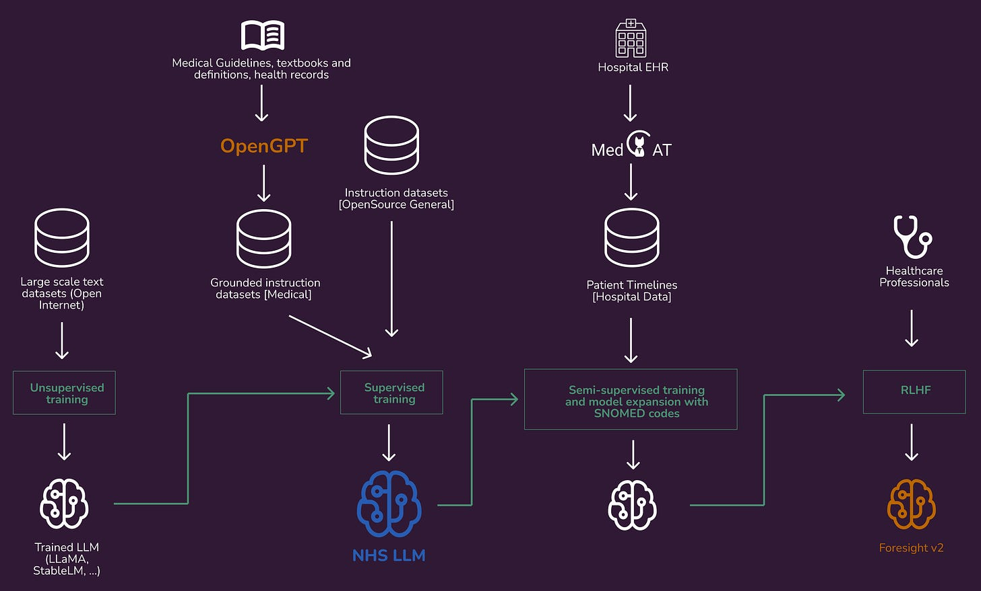
Localized Natural Language Model

Slide 37
Thank you all for your attention today!
Reporter：Yu Junwei
Notes:
Any comments and questions are welcome
Homomorphic encryption is a large category, in fact, for different applications, in fact the algorithm has the very big difference
In our requirements, we need to maintain some data relationships that are immutable even when they are encrypted, and homomorphic changes can be made to data relationships that are not helpful for matching
Not in conflict with blockchain, our design standard is a more basic facility for blockchain-based SSI

